Slide 1
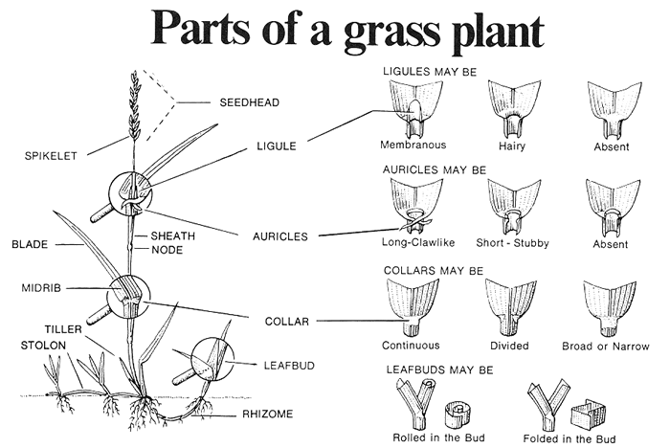

Slide 2
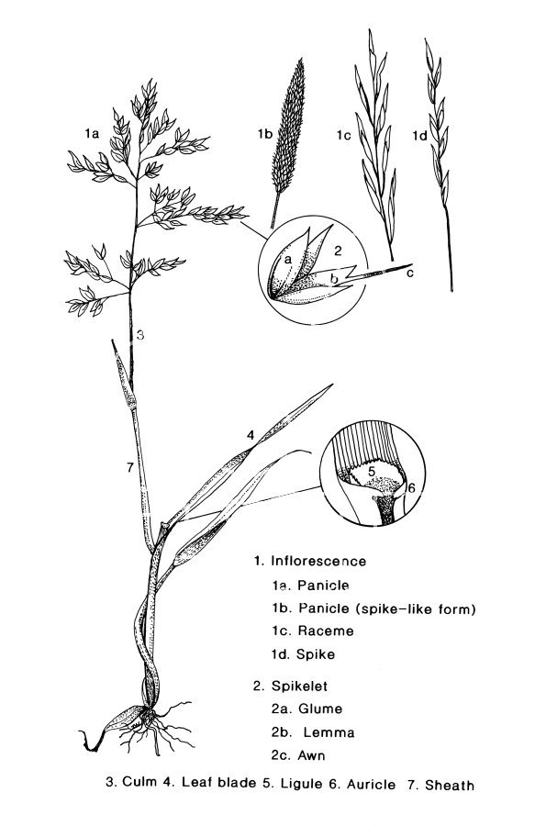

Slide 3
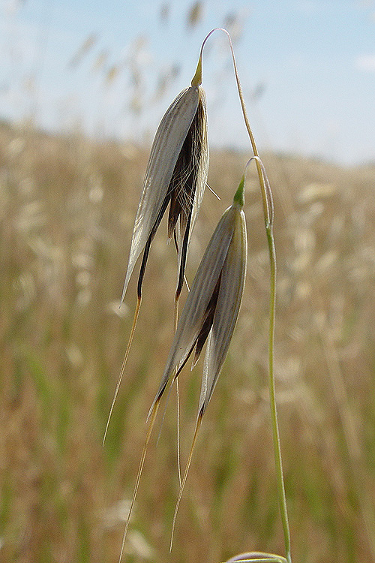
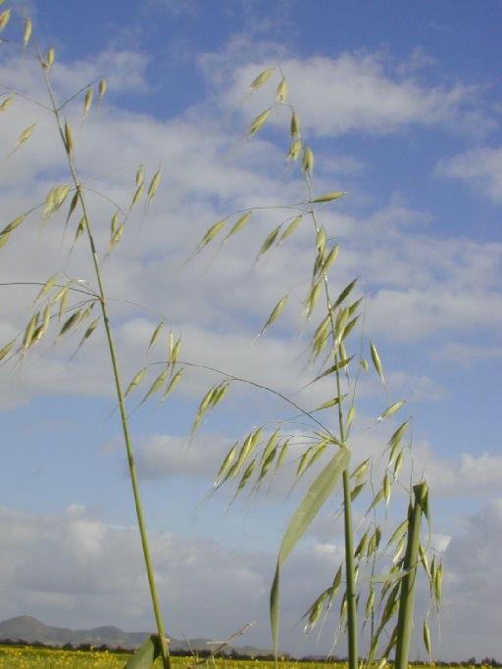
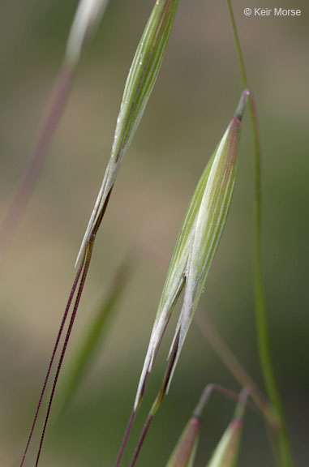
Avena

Slide 4
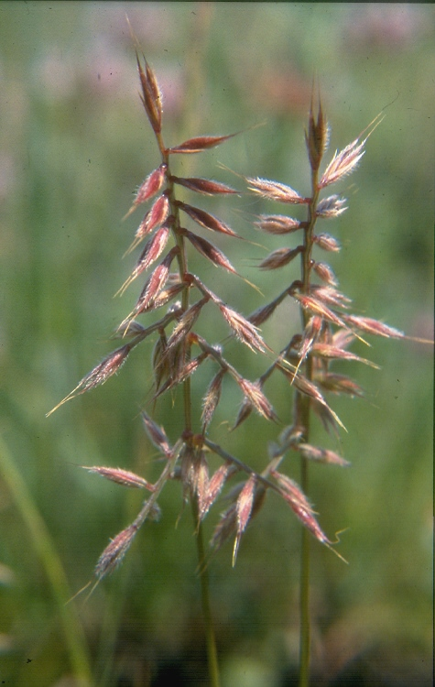
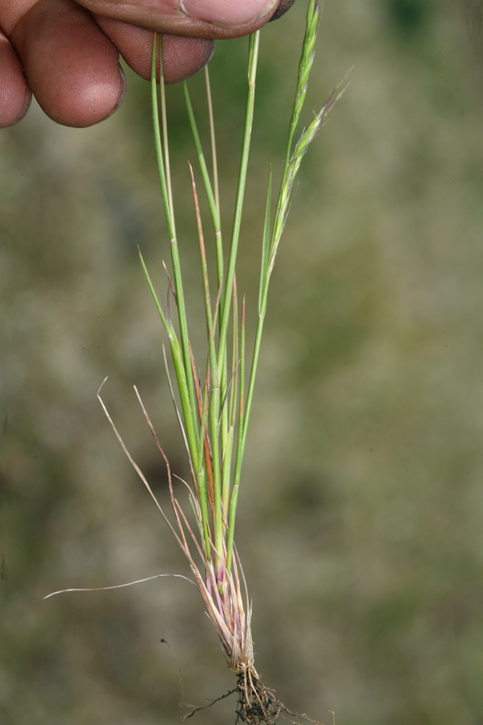
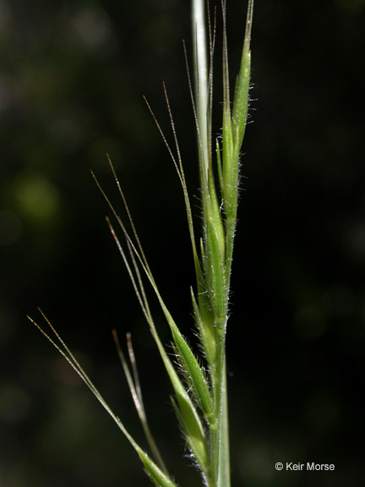
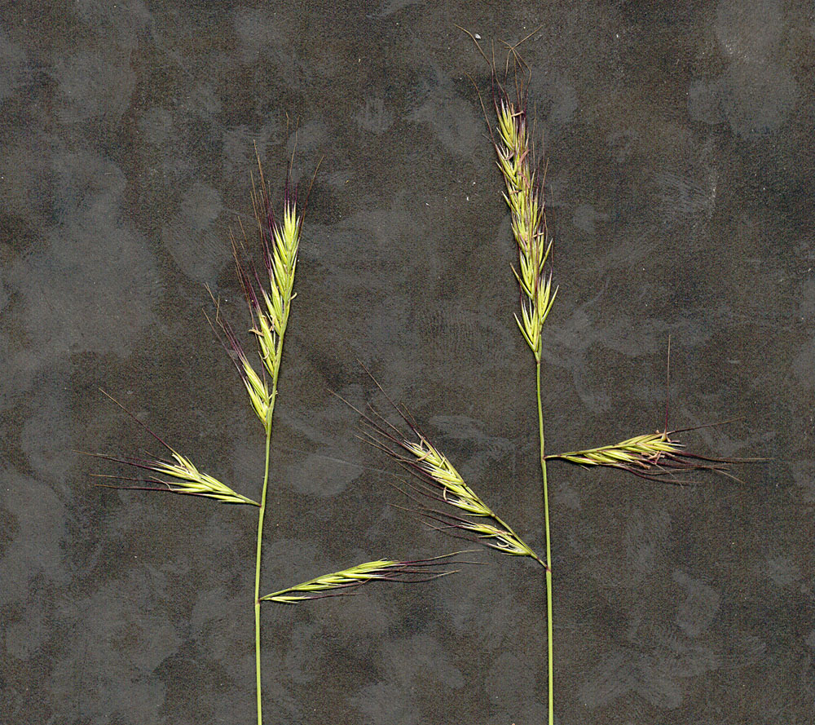
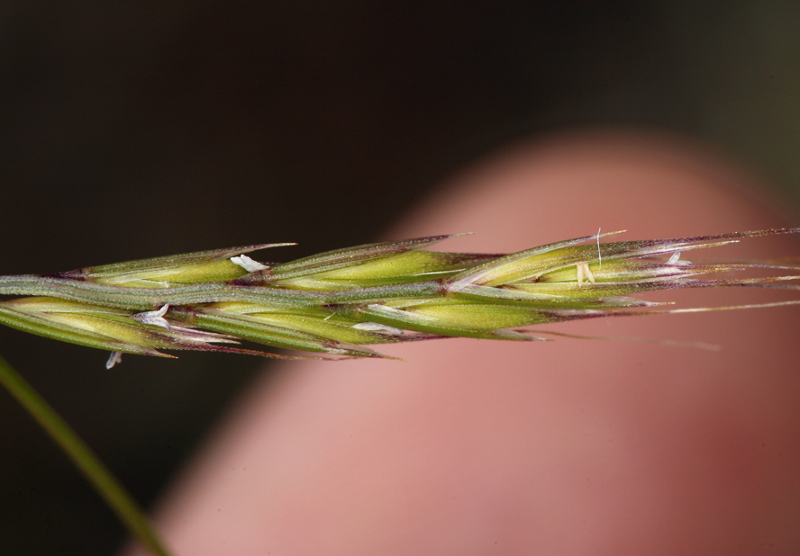
Vulpia (Festuca) microstachys

Slide 5
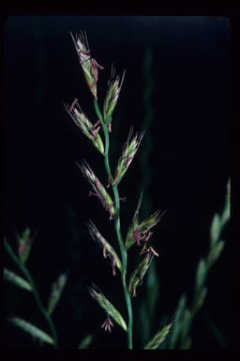
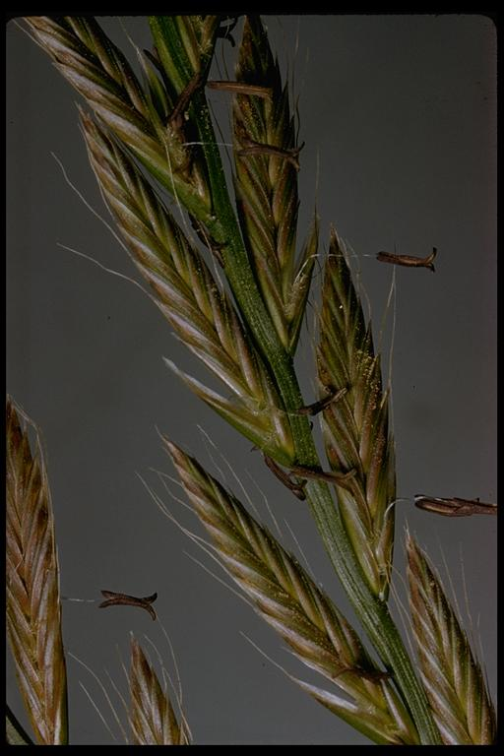
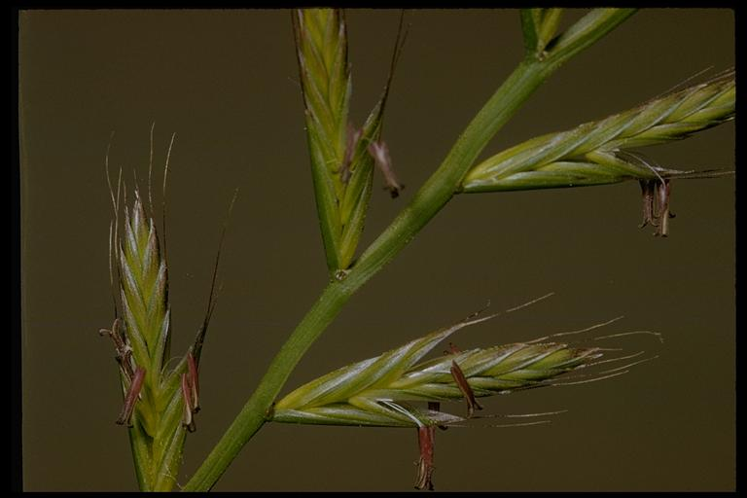
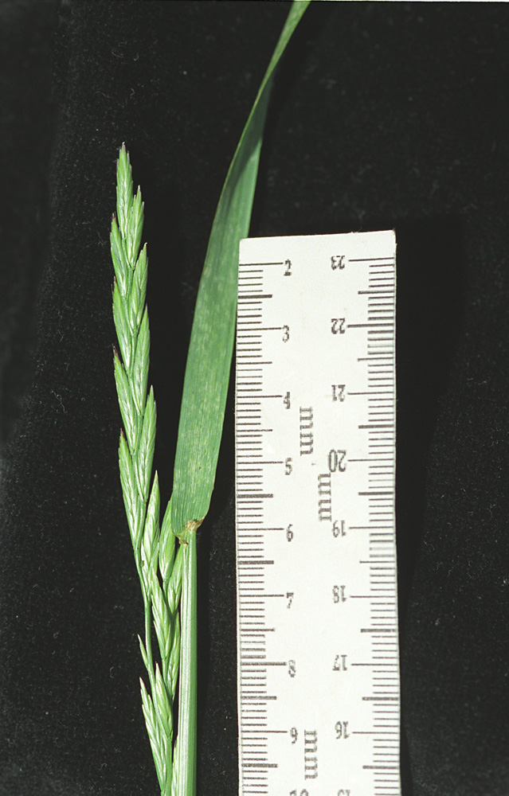
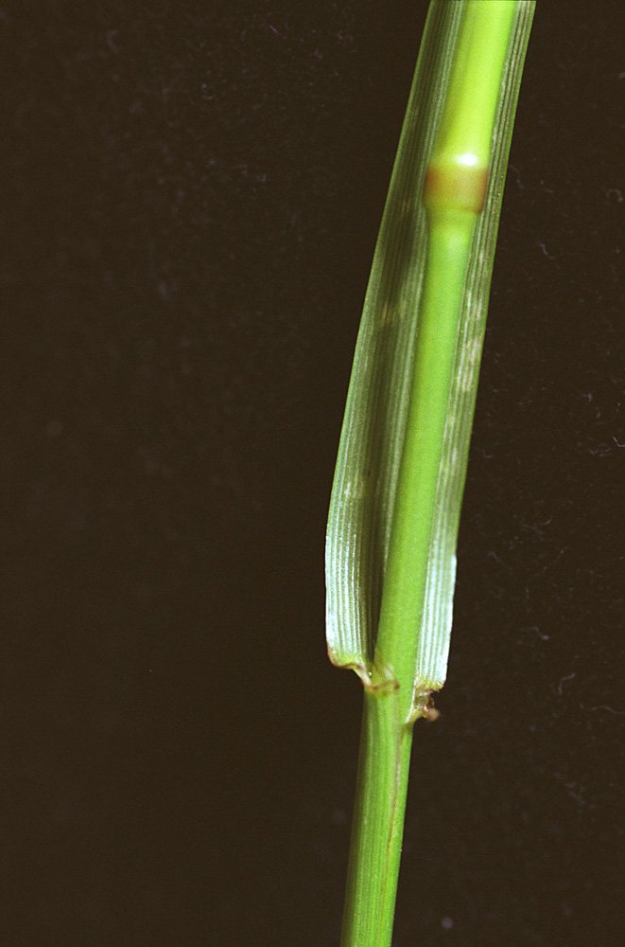
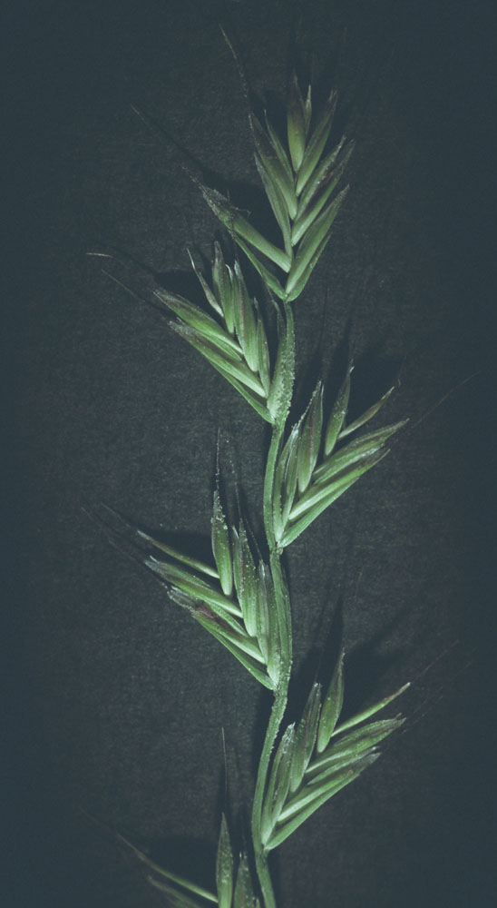
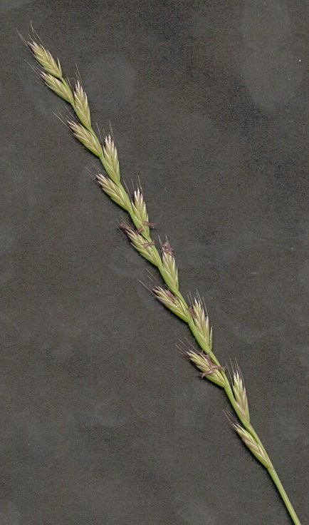
Lolium multiflorum (Festuca perennis)

Slide 6
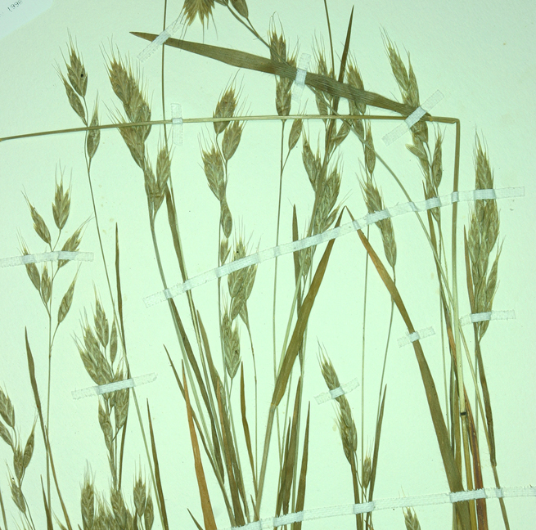
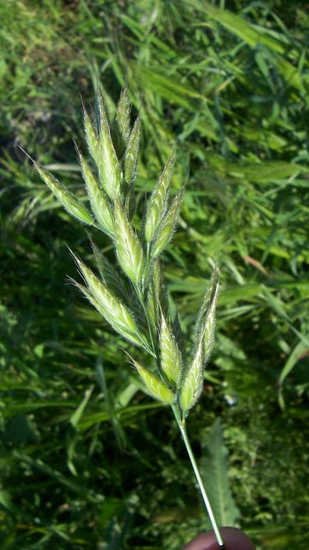
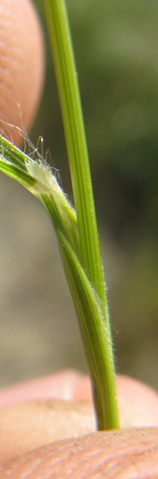
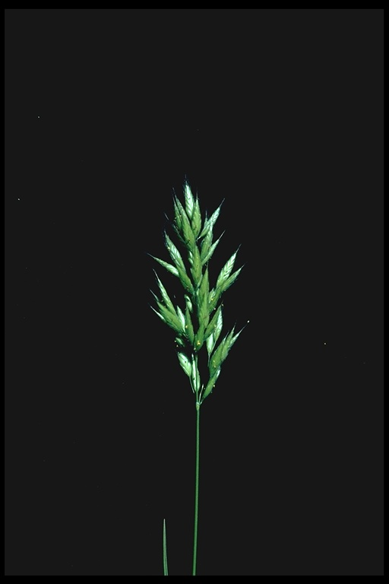
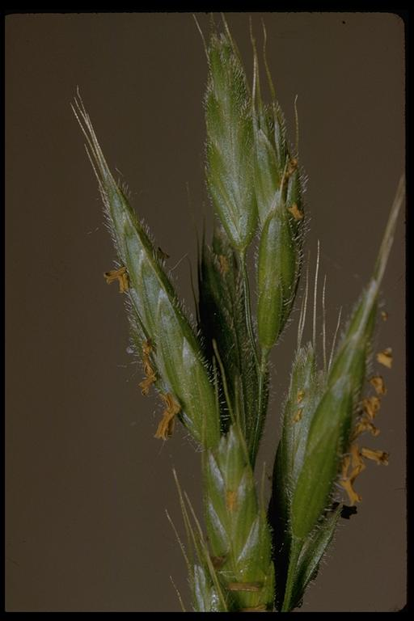
Bromus hordeaceus
Shorter awns 6-8 mm
Lemmas rounded, no keel, obvious veins
Seed head more hairy
All spikelets ascending or erect (don’t droop down)

Slide 7
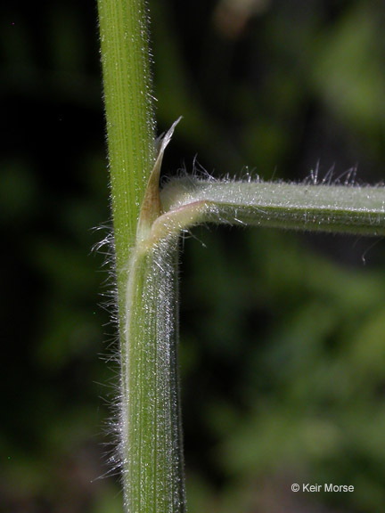
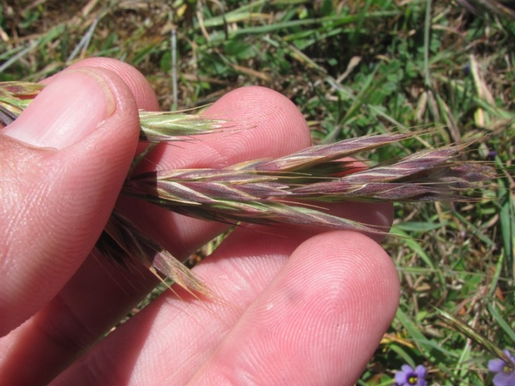
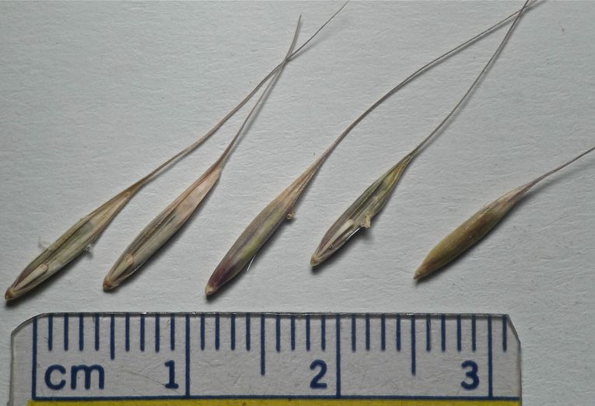
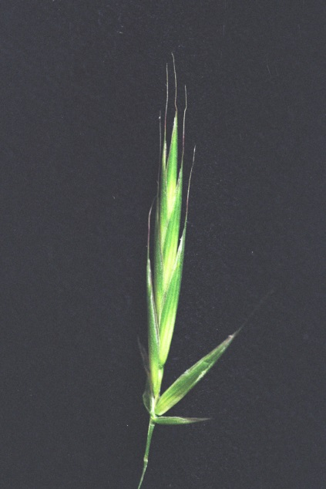
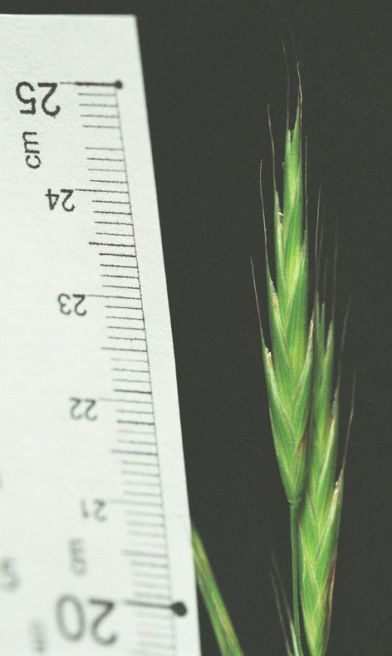
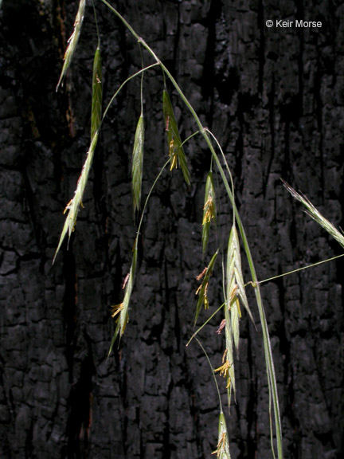
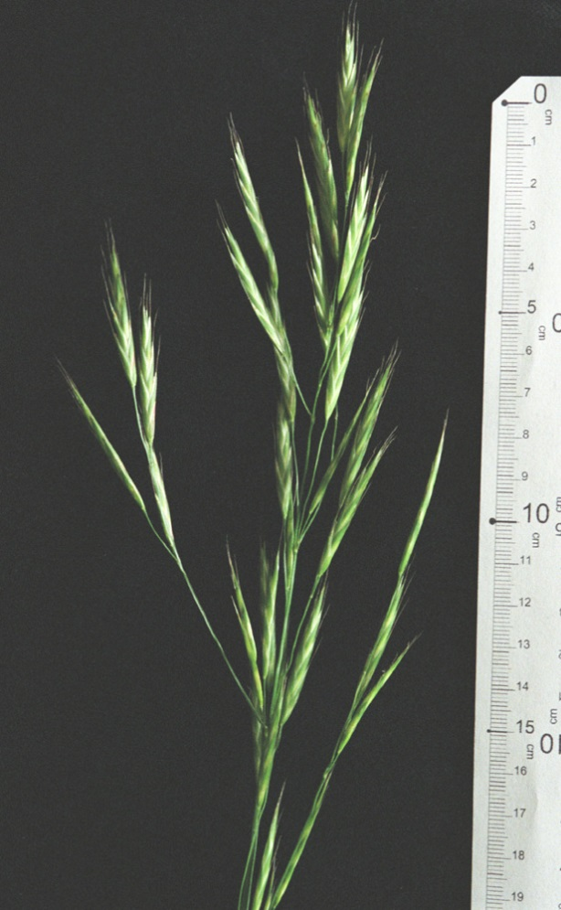
Bromus carinatus
Longer awns than hordeaceus 7-15mm
Strongly flattened spikelets
Lemmas strongly keeled (like keel of boat- sharp edge), faint veins
Panicles can droop down later in season (spread away from stem)

Slide 8
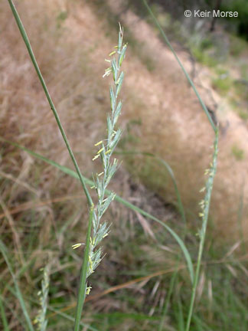
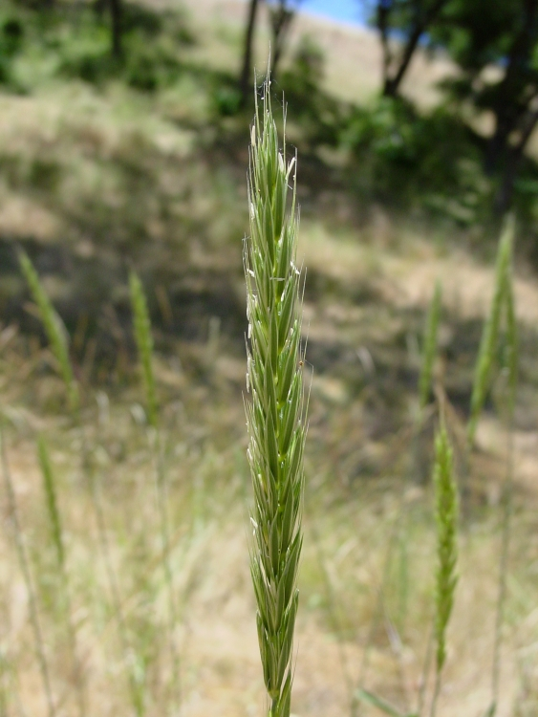
Elymus glaucus Leymus triticoides (shorter awns)

Slide 9
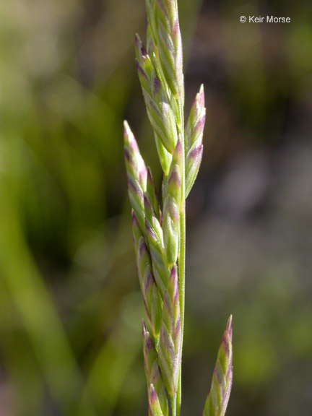
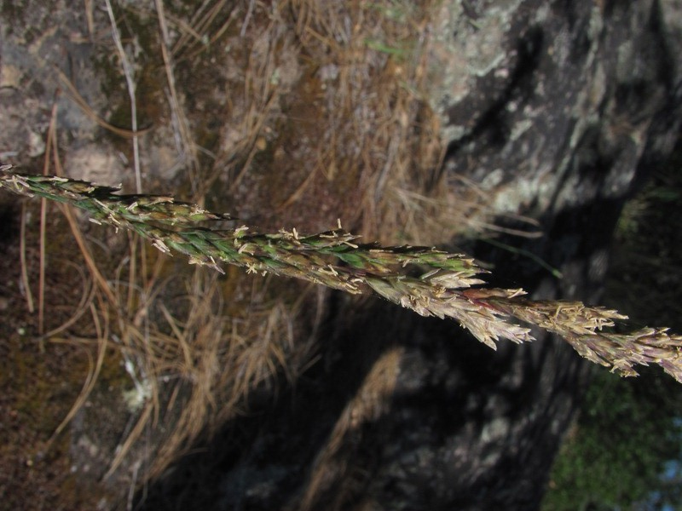
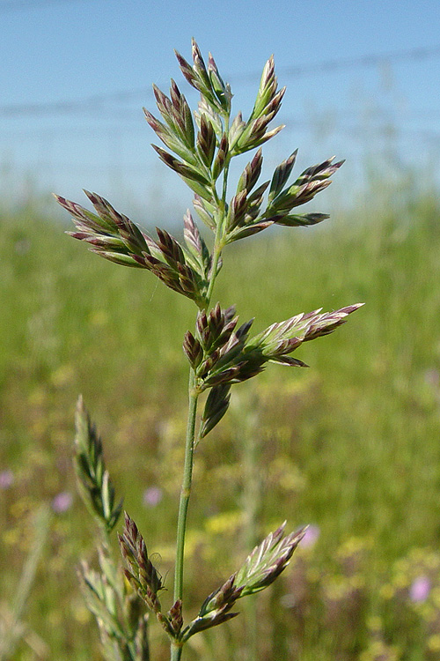
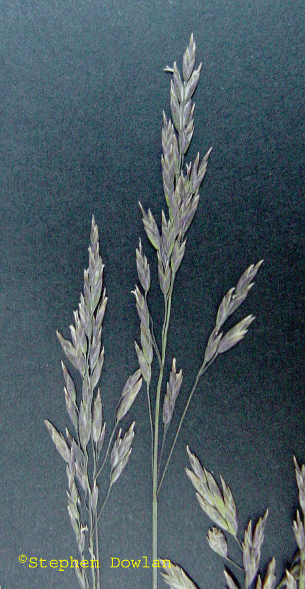
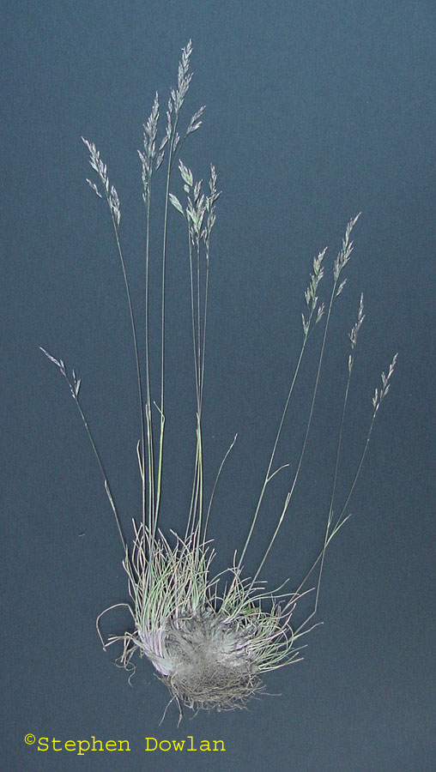
Poa secunda

Slide 10
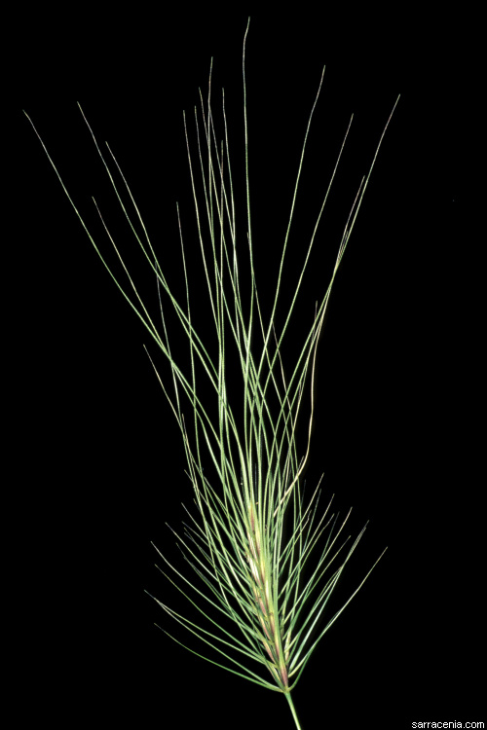
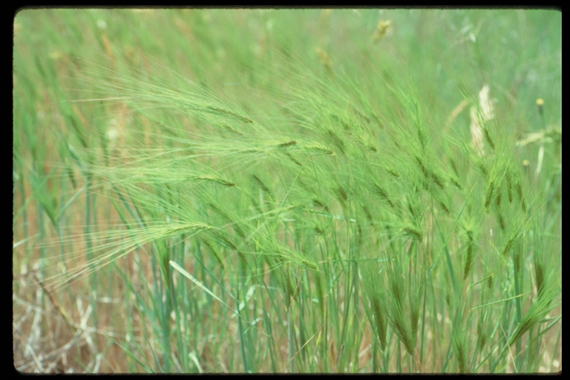
Taeniatherum

Slide 11
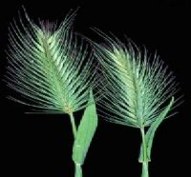
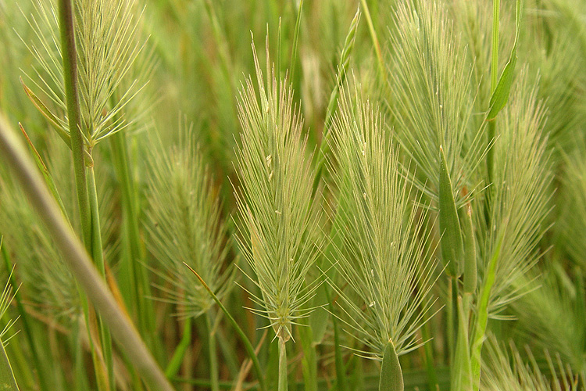
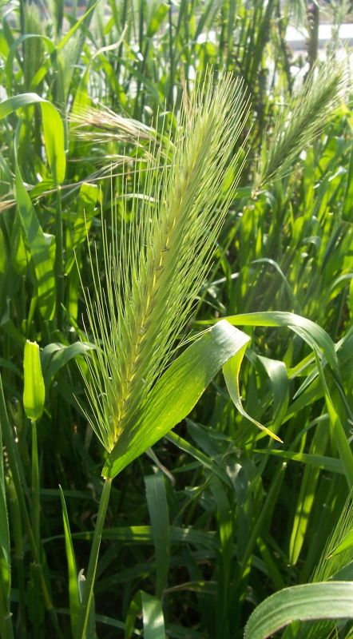
Hordeum
Hordeum marinum (Mediterranean barley)
More common in moisture areas (including wetlands)
Lacks auricles (or are less than 2mm long)
Hordeum murinum (hare barley)
Well-developed auricles that clasp the stem.
Key distinction from medusahead: seed head is more “beefy” and “solid” in center
Hordeum marinum, H. murinum

Slide 12
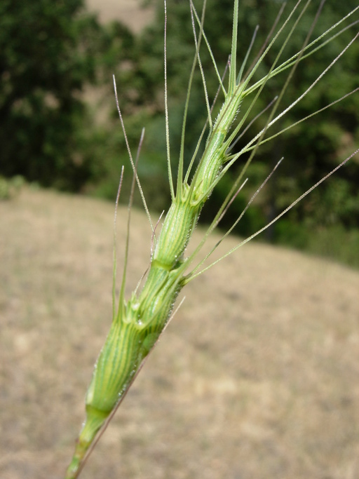
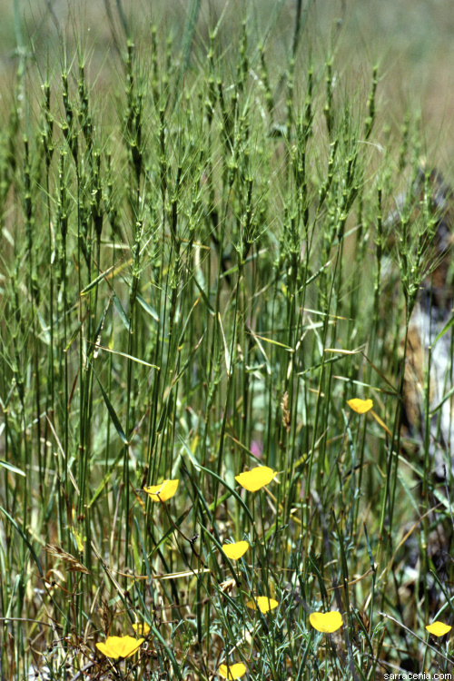
Aegilops

Slide 13
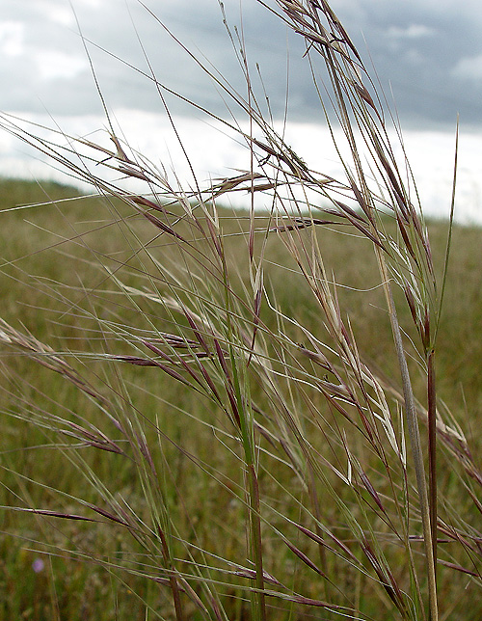
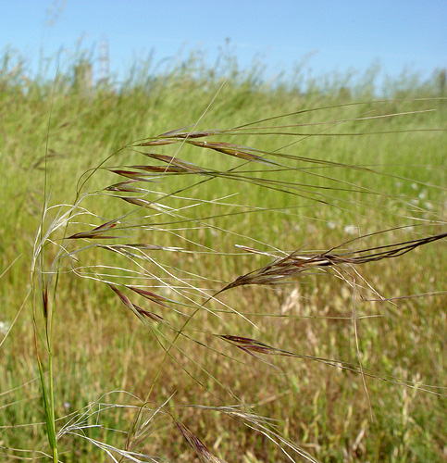
Stipa pulchra
Needlegrasses grow in clumps and have rolled leaves and only one finely hairy flower in each spikelet. Purple needlegrass is distinctive in having an open loose cluster of flowers with spreading branches called “panicles.” Look for the pair of reddish, narrow, leaf-like structures (called “glumes”) at the base of each floret (grass flower); the glumes are tapered from base to tip, with the tip narrowing to a sharp point (hence the name needlegrass).

Slide 14
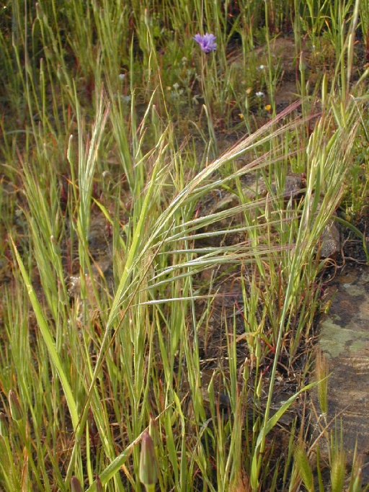
Bromus diandrus
The open branching flower head resemble that of oats. Large spikelets with needlelike awns, 1 to 2 inches (2.5–5 cm) long, distinguishes ripgut brome from the much shorter awns of soft brome. The individual flowers have tiny, rough teeth that can injure livestock and pets.

Slide 15
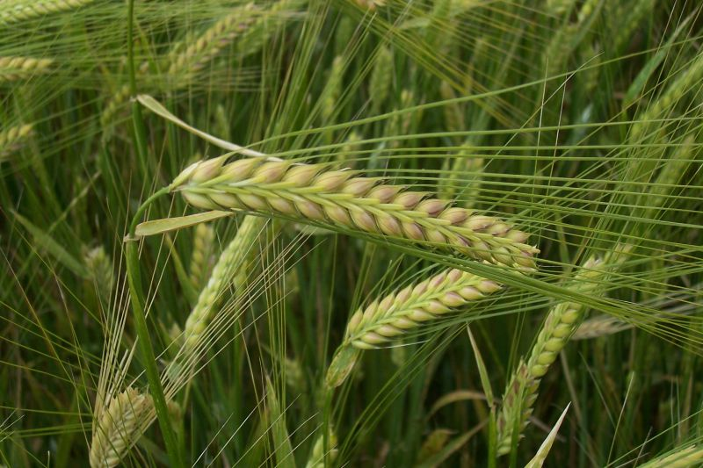
Hordeum vulgare (barley, ag crop)

Slide 16
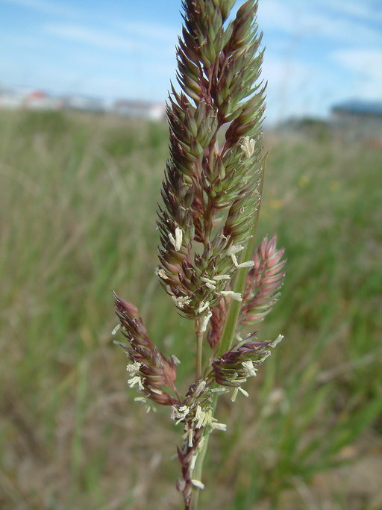
phalaris

Slide 17
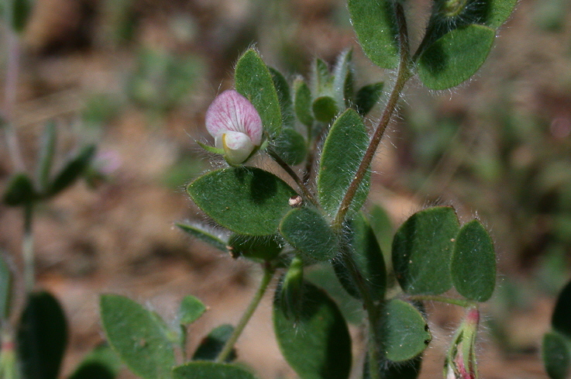
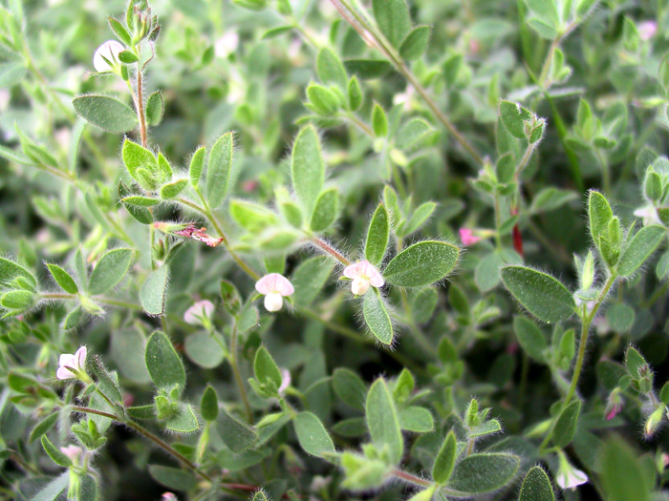


Lotus (Acmispon americanus)

Slide 18


Lupinus bicolor

Slide 19




Trifolium subterraneum

Slide 20

Vicia sativa

Slide 21


Melilotus-Sweet clover

Slide 22


Bindweed (Convolvulus), morning glory

Slide 23








Erodium botrys leaves simple, shallow to deep lobes, sepal bristly fruit beak 5-12 mm
E brachycarpum- simple lobed leafs, fruit beak 5-8 mm
E cicutarium
Compound rosette leaves, deeply dissected leaflets, bristly sepal, 2-5mm peak beak
E moschatum
Compound rosette leaves, tooth or lobed, glabrous sepal tip, fruit beak 2-4 cm long

Slide 24



Geranium species

Slide 25






Lactuca serriola

Slide 26




Senecio vulgaris, grounsel

Slide 27



Horseweed (Conyza, Erigeron)

Slide 28


Yellow starthistle

Slide 29



Milk thistle (Silybum marianum)

Slide 30


Italian thistle (Carduus pycnocephalus)

Slide 31





Amsinckia

Slide 32


Galium aparine

Slide 33



Capsella (shepard’s purse)

Slide 34



Veronica (speedwell)

Slide 35






Calendrinia ciliatum- redmaids

Slide 36



Kickxia elatine (fluellin)

Slide 37







Brassica nigra- black mustard
Older leaves can be rough- spiky back of leaves

Slide 38





Brassica rapa
Bumps on leaves

Slide 39


Helianthus

